Slide 1
NLP format

Slide 2
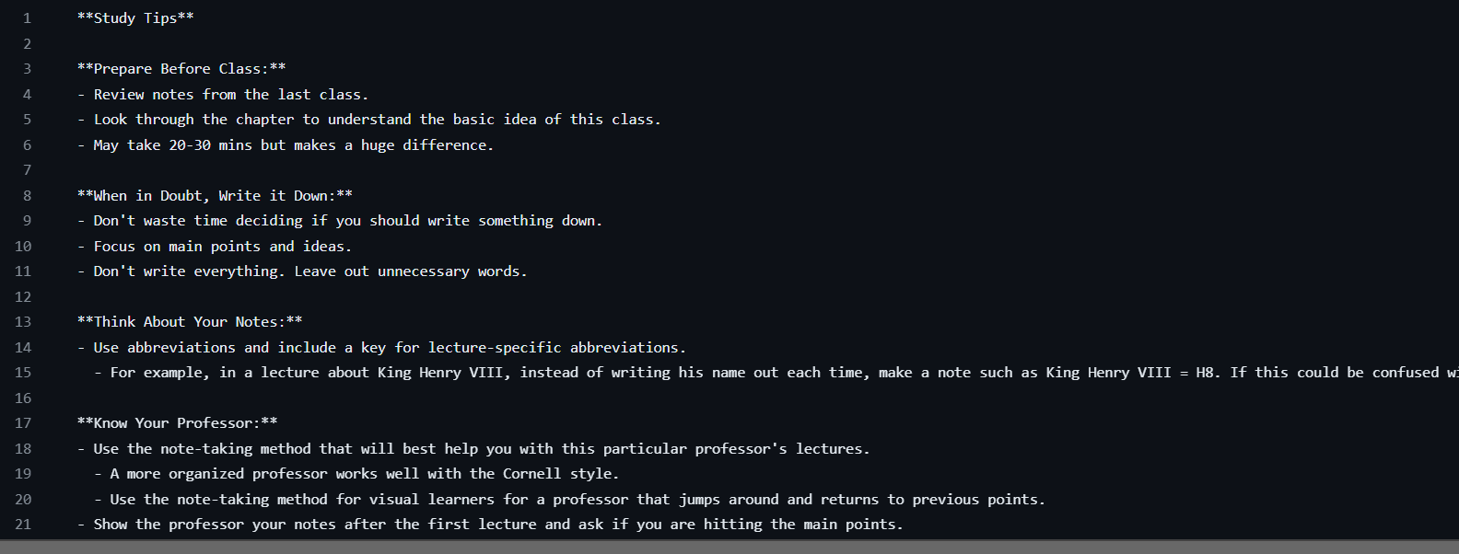
LLM formatted text

Slide 3


NLP second format
Using Rake NLTK to find keywords inside the text
Highlighted the keywords and identify special words (bold) using flag

Slide 4
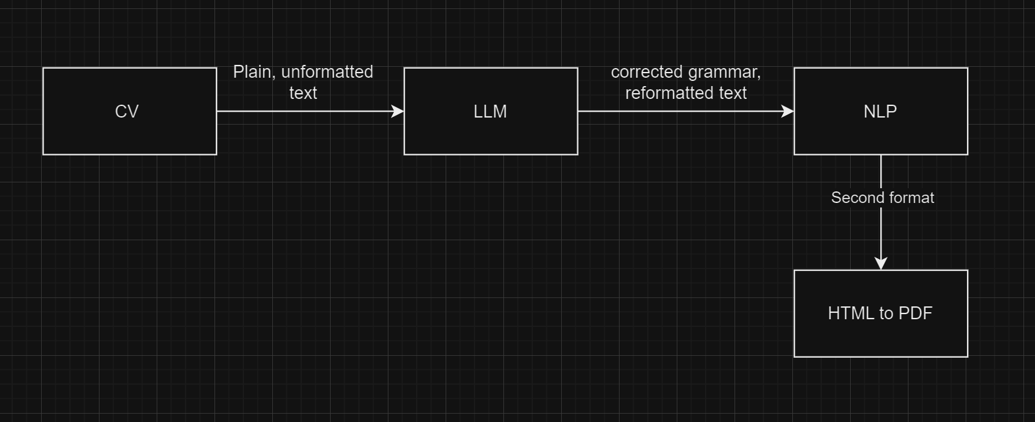

Slide 5
